Slide 1

Department of CSE
(ARTIFICIAL INTELLIGENCE AND MACHINE LEARNING)
MEDICINAL LEAF IDENTIFICATION USING NN
Under the Supervision
Dr. Joshuva Arockia Dhanraj
Presented By:
Kasala Bhavana (ENG22AM0153)
Lakshya U Reddy (ENG22AM0169)
Nishat N Shahu (ENG22AM0184)
Tanya Gopal (ENG22AM0193)

Slide 2
Overview
Abstract
Problem Statement
Introduction
State of the Art work(Literature Review)
Methodology
Results
Web Application
Conclusion and future works
References

Slide 3
Abstract
India with a rich heritage of floral diversity, is well known for its medical plant wealth, but their identification is one of the major issues .
A study published in the Journal of Ethnopharmacology estimated that approximately 70-80% of the Indian population depends on traditional medicine systems.
The model is designed to classify images of plants into various categories, aiding in the accurate identification of medicinal plants.
Our approach is to collect data, clean the data, build model, train and test the model and then deploy the model.
The ultimate goal is to provide a reliable tool that can be used for educational purposes, botanical research, and potentially in medicinal plant discovery and application.

Slide 4
Problem Statement
Problem: Accurate identification of medicinal plant is essential for their use in medicine. Manual identification by experts is slow, error-prone, and not scalable, especially in areas with limited botanical expertise. How do we assist botanists, researchers, and the public in recognizing and utilizing these plants effectively.?
Solution: To address this problem, we have developed a deep learning-based model using Convolutional Neural Networks (CNNs) to automate the identification of medicinal plants from images. CNNs are particularly well-suited for image recognition tasks due to their ability to learn and extract hierarchical features from images.

Slide 5
Introduction
Unlike traditional machine learning models, CNNs automatically learn to extract important features from images through multiple layers of convolution and pooling, making them particularly effective for image recognition tasks.
This CNN model is trained on a dataset of plant images, allowing it to learn distinguishing features and accurately identify different species.
This automated approach not only speeds up the identification process but also reduces the reliance on expert knowledge, making it accessible and scalable for wider use in various fields, including botany, pharmacology, and agriculture.

Slide 6
State of the Art-work
Paper Title and Author Name | Conference /Journal Name and year | Technology used | Results | What you infer
AyurLeaf: A Deep Learning Approach for Classification of Medicinal Plants Identification of Indian Medicinal Plants from Leaves using Transfer Learning approach | Published in: TENCON 2019 - 2019 IEEE Region 10 Conference (TENCON) DOI: 10.1109/TENCON.2019.8929394 Published in: 2021 5th International Conference on Trends in Electronics and Informatics (ICOEI) DOI: 10.1109/ICOEI51242.2021.9452917 | Deep Learning based Convolutional Neural Network (CNN) model Convolutional Neural Network (CNN) and Transfer Learning | maximum accuracy achieved for a single run out of five consecutive runs is 98.46% The inception V3 architecture has the highest validation accuracy and F1 score of 0.8968 and 0.8843. Overall accuracy of 0.9732. | We inferred image acquisition and image preprocessing We will infer segmentation process and efficient architecture

Slide 7
State of the Art-work
Paper Title and Author Name | Conference /Journal Name and year | Technology used | Results | What you infer
Medicinal Plant Identification in Real‐Time Using Deep Learning Models. Identification of medicinal plant and their usage by using deep learning | Published : 7th December,2023 22nd March,2024 | Deep Learning based Convolutional Neural Network (CNN) model Deep learning | Geometrical augmentation was performed on the leaf images and the model was trained ,tested and evaluated the DL model was able to correctly identify medicinal leaves at an accuracy rate of 98.3% Developed and trained a model to identify medicinal plants and display its usages using images taken with variations with an accuracy of 85.1%. | The data was fed into model, and it was trained tested and validated using DL model We plan in making a website/app which displays the medicinal plant and its usages in the future.

Slide 8
Design and Proposed Methodology

Slide 9
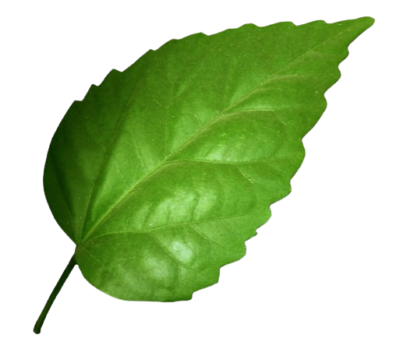

Training, Testing and pre-processing
Web-application Input from user
Training images
Validation
images
Training
images
Pre-Processing
Testing
images
Pre-Processing
Trained Model
Model Deployment
Plant Image
Plant Information
Building and compiling model
Building layers
Save the model
Compiling
Plant Information
Images
CNN model
Plant Dataset

Slide 10
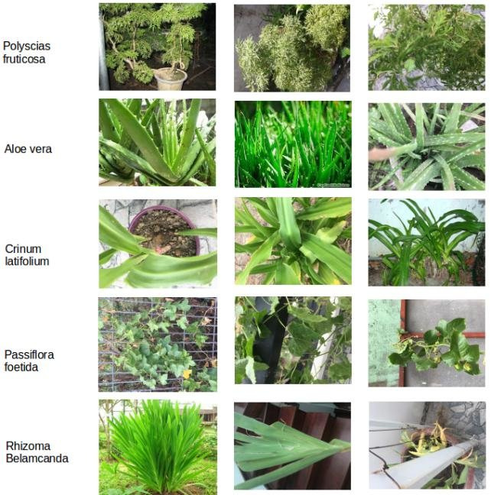
Data Collection :
The leaf samples of different medicinal plants are collected from ncbi library and stored in jpg format.
We have total 80 classes(i.e 80 species of medicinal leaves).
We have divided our dataset into 3 parts:
Training set: which has 6899 images.
Validation set: which has 6899 images.
Test set: which has 2068 images.

Slide 11
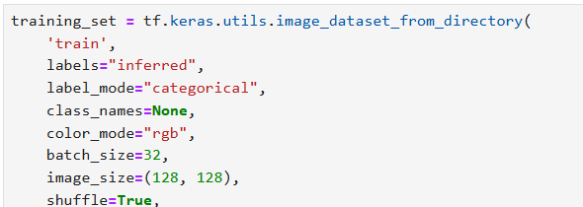
Data Pre-processing :
Pre-processing the data ensures that the data fed into the model is standardized, well-labeled, and efficiently batched, which are key factors in achieving good model performance.
We have used keras library function to pre-process the training and validation set. This function will,
resize – (128,128)
Normalize – Pixel value range 0 to 1
Shuffle – True, so that the model doesn’t memorize in order.
Batch size – 32 for each set.

Slide 12
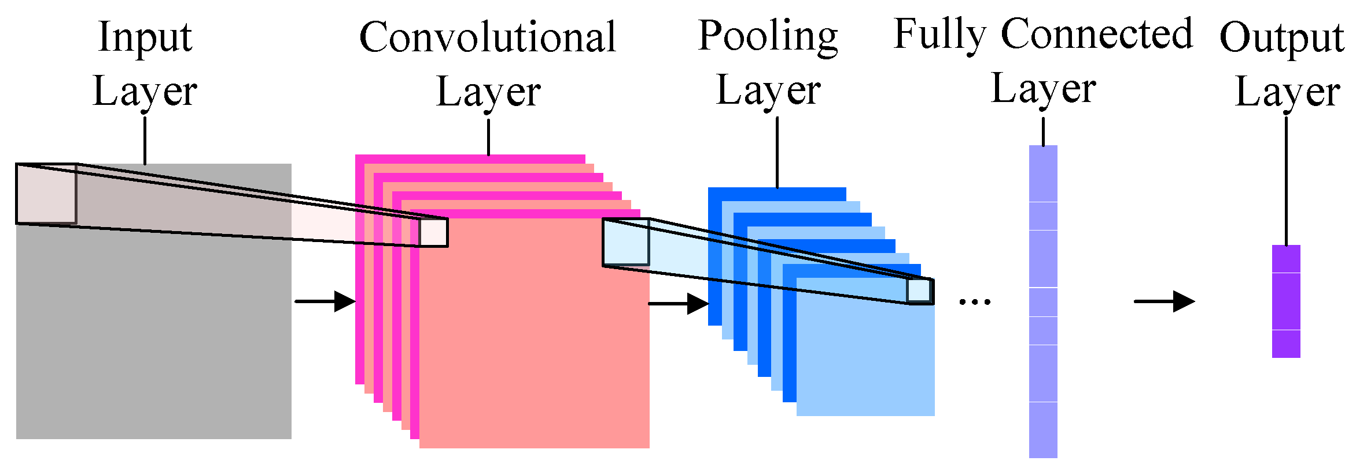

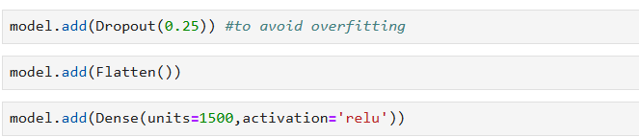
Model Building:
Our CNN model consists of several layers.
We start with convolutional layers to extract features from the images,
Pooling layers to reduce dimensionality.
A dropout layer used in the NN model
to prevent overfitting.
Finally, we use dense layers for classification.

Slide 13
Compiling the model:
Once the model architecture is defined, we compile the model.
Compiling involves specifying the optimizer, loss function, and evaluation metrics.
We used the Adam optimizer, categorical cross-entropy loss, and accuracy as our metric.
And finally we print the summary of our model.

Slide 14
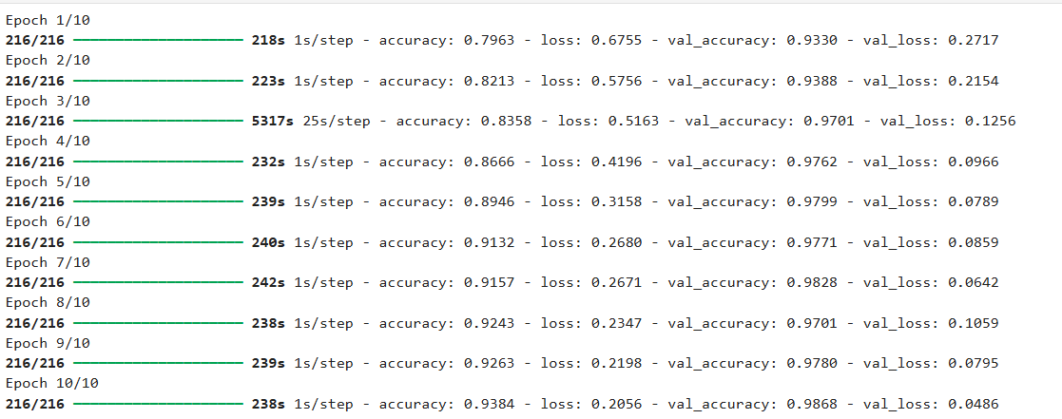
Model Training:
Training the model involves feeding the preprocessed images into the model.
We trained our model for 10 epochs, with each epoch representing a full pass through the training dataset.

Slide 15
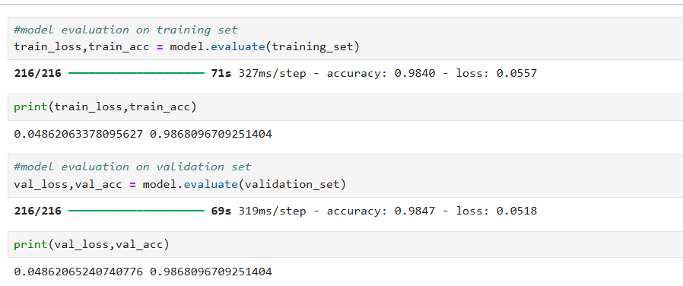
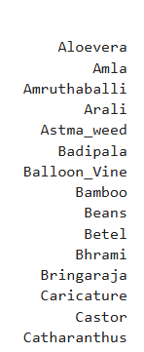
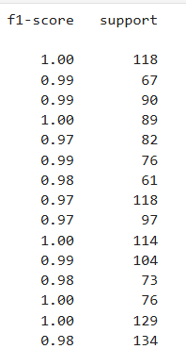
Model Evaluation:
After training, we evaluate the model on the validation set to assess its performance.
To get a deeper understanding of the model's performance, we calculate additional metrics such as F1-score.
We also plot a confusion matrix to visualize the model's predictions versus the actual classes.

Slide 16

Model Saving and Loading :
Once we are satisfied with the model's performance, we save the model in keras zip file or h5 file for future use.
This allows us to load the model later without retraining it from scratch.

Slide 17
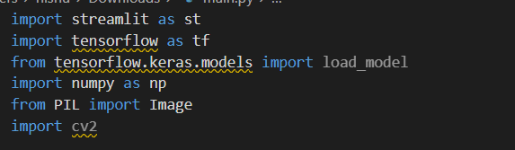
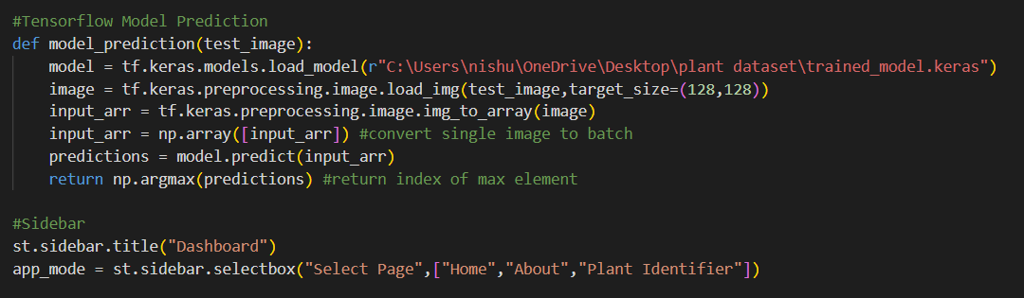
Web Application
We deploy the model in a suitable environment as a part of web application for users to upload their image.
We have developed an application called “Medicinal Plant Identifier” using streamlit.
The user can upload an image of any leaf and our model will predict which kind of a medicinal leaf it is.
URL: main · Streamlit

Slide 18
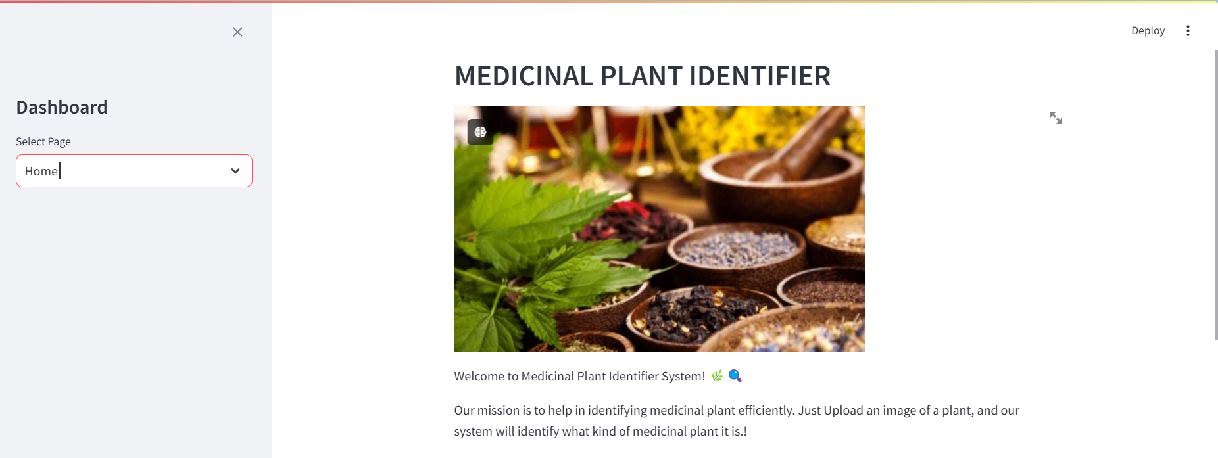
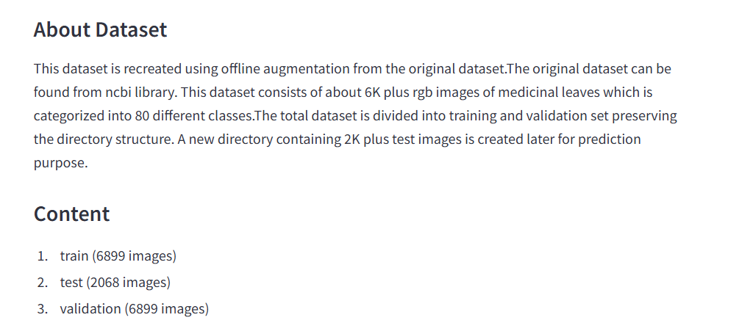
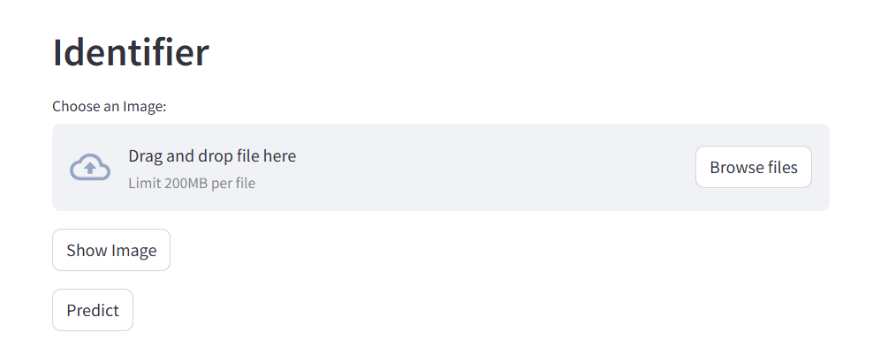
Homepage
About page
Plant Identifier page

Slide 19
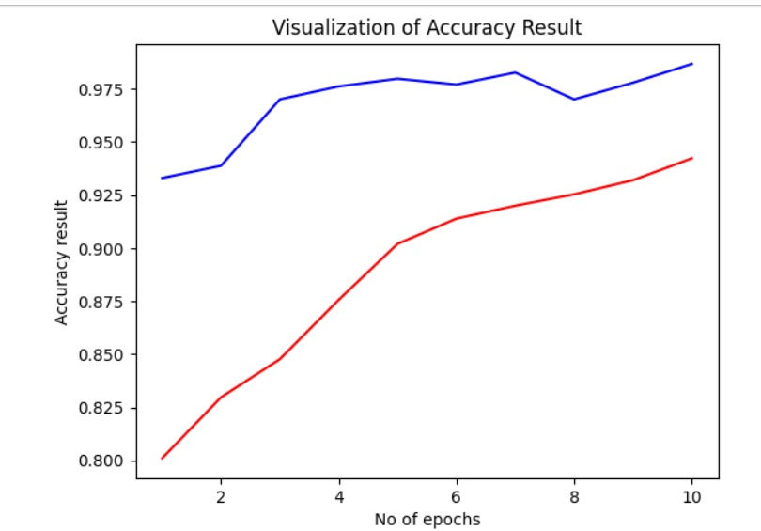
Results
Training and Validation Accuracy Result:
Training Accuracy: The model showed a steady increase in accuracy over the epochs, indicating that it was learning the distinguishing features of different plant species effectively. Training Accuracy: 93.8.
Validation Accuracy: The validation accuracy also improved consistently, demonstrating that the model generalizes well to unseen data. Validation Accuracy: 98.6
Training Accuracy
Validation Accuracy

Slide 20
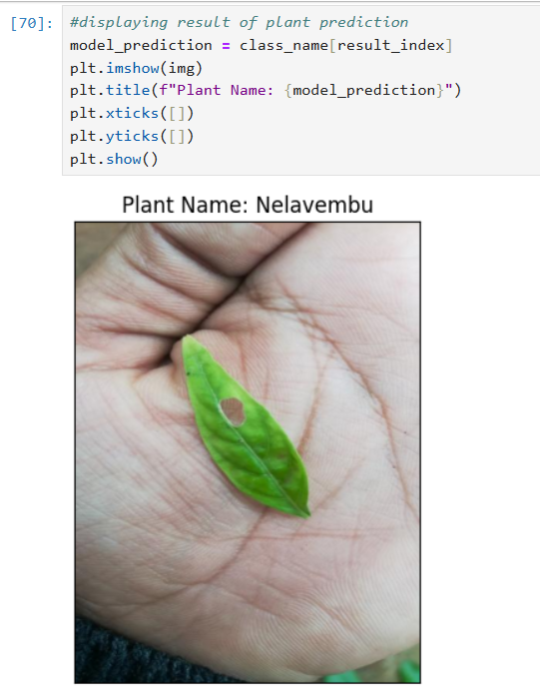
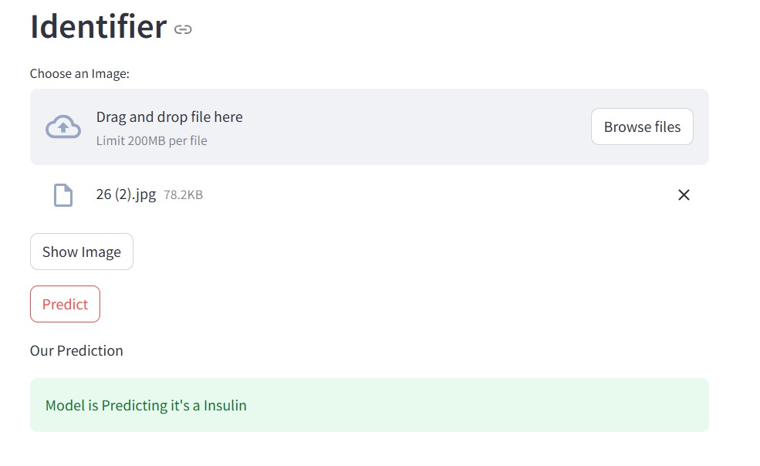
Results
Deployment Testing:
Finally, the model was deployed and tested with images to ensure it performs well. An example image was used to verify the model's prediction capabilities shown below:
Model Prediction (i)
Model Prediction (ii)

Slide 21
Conclusion:
In conclusion, we have successfully developed a CNN model to identify medicinal plants from images. Our model demonstrates good accuracy and can be used for practical applications in various fields. Future work could involve expanding the dataset, improving the model architecture, and deploying the model in real-world scenarios.
Future Work:
In future our plan is to increase the size of the dataset by increasing the samples as well as by adding new species of medicinal plants.
We also plan to build a real-world application where users can scan the leaf using camera or upload image from gallery and get the name of the leaf as well as the benefits of that medicinal plant.

Slide 22
References
[1] M.R. Dileep; P.N. Pournami,” AyurLeaf: A Deep Learning Approach for Classification of Medicinal Plants”, Published in: TENCON 2019 - 2019 IEEE Region 10 Conference (TENCON) DOI: 10.1109/TENCON.2019.8929394
[2] Arunaggiri Pandian K; Sai Kumar T S, “Identification of Indian Medicinal Plants from Leaves using Transfer Learning Approach Published in: 2021 5th International Conference on Trends in Electronics and Informatics (ICOEI) DOI: 10.1109/ICOEI51242.2021.9452917
[3] C.Amuthalingeswaran, Mr. M.Sivakumar , Dr. P.Renuga, S.Alexpandi, S.Santhana Hari, “IDENTIFICATION OF MEDICINAL PLANT’S AND THEIR USAGE BY USING DEEP LEARNING” Proceedings of the Third International Conference on Trends in Electronics and Informatics (ICOEI 2019) IEEE Xplore Part Number: CFP19J32-ART; ISBN: 978-1-5386-9439-8
[4] S. Kavitha, T. Satish Kumar, E. Naresh, Vijay H. Kalmani, Kalyan Devappa Bamane & Piyush Kumar Pareek,” Medicinal Plant Identification in Real‐Time Using Deep Learning”, Published on :07 December 2023,volume(5) article number 73(2024).

